Slide 1
Consistency Policy
Accelerated Visuomotor Policies via Consistency Distillation
GONG Ying
gong.ying@connect.umac.mo
2024.5.17

Slide 2
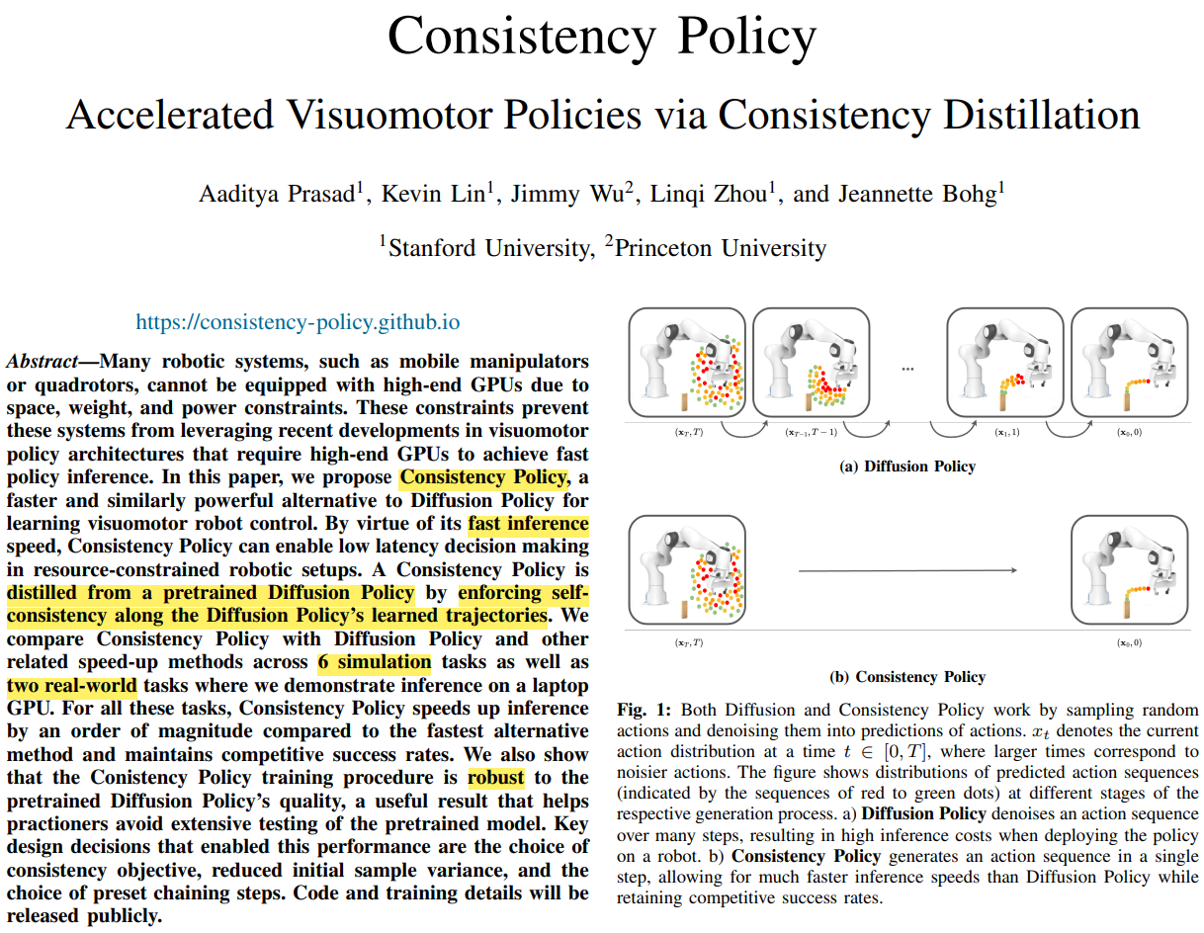
arXiv:2405.07503v1
May 13, 2024

Slide 3
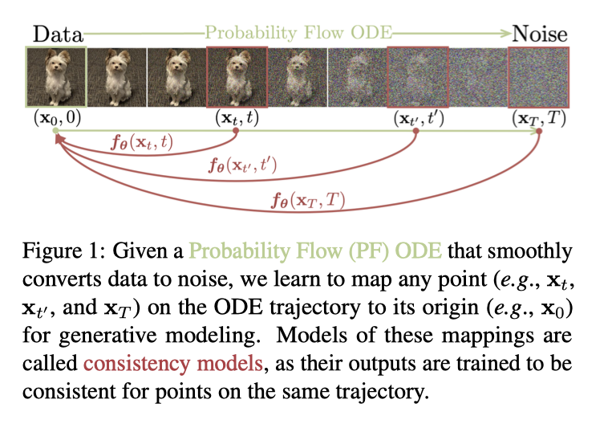
Consistency Distillation
Consistency Model

Slide 4
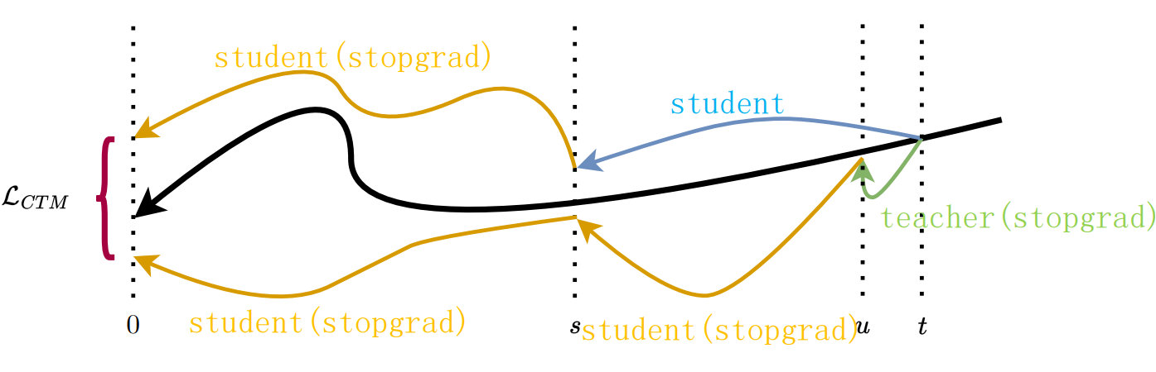
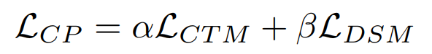
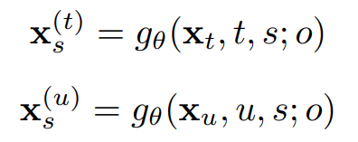
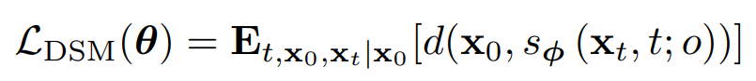
Consistency Distillation
Consistency Model – CTM Loss

Slide 5
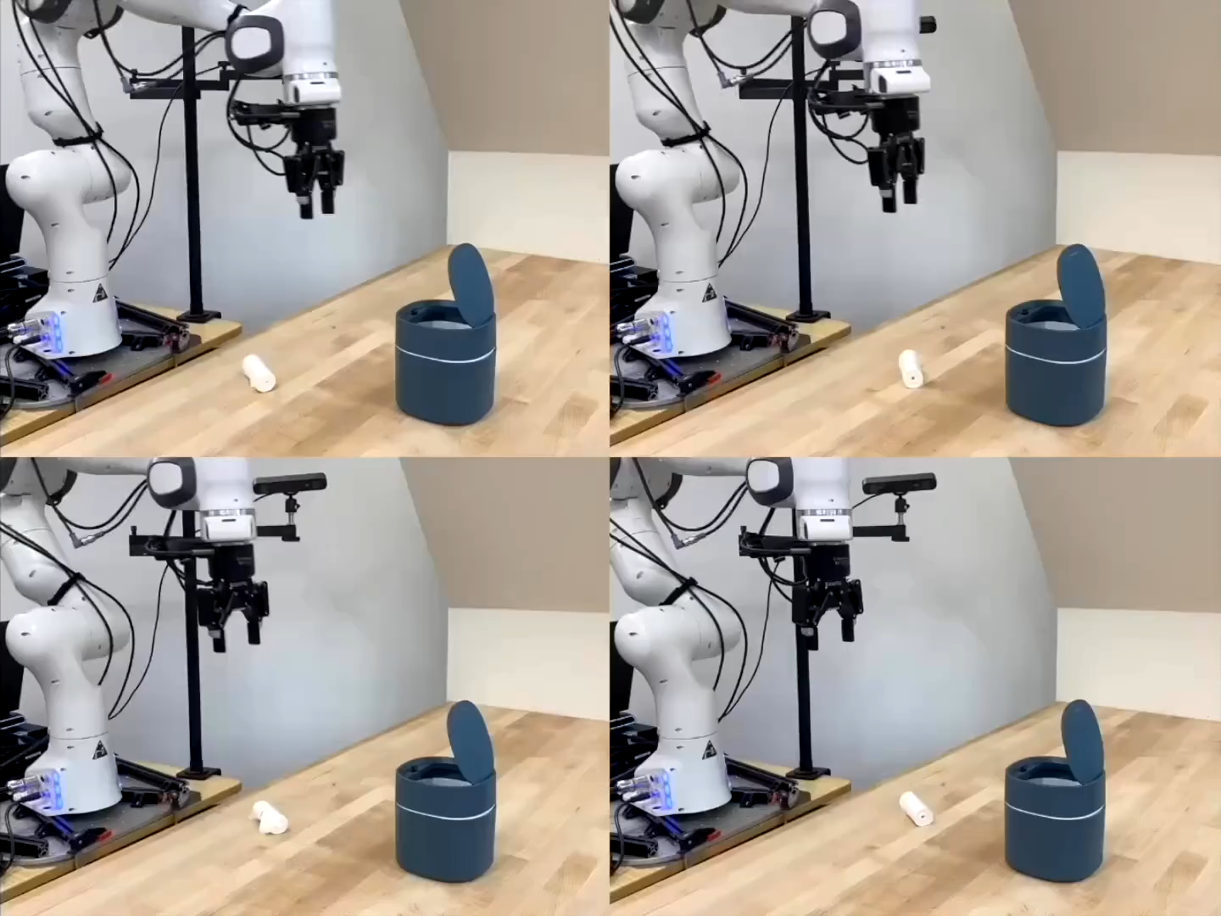
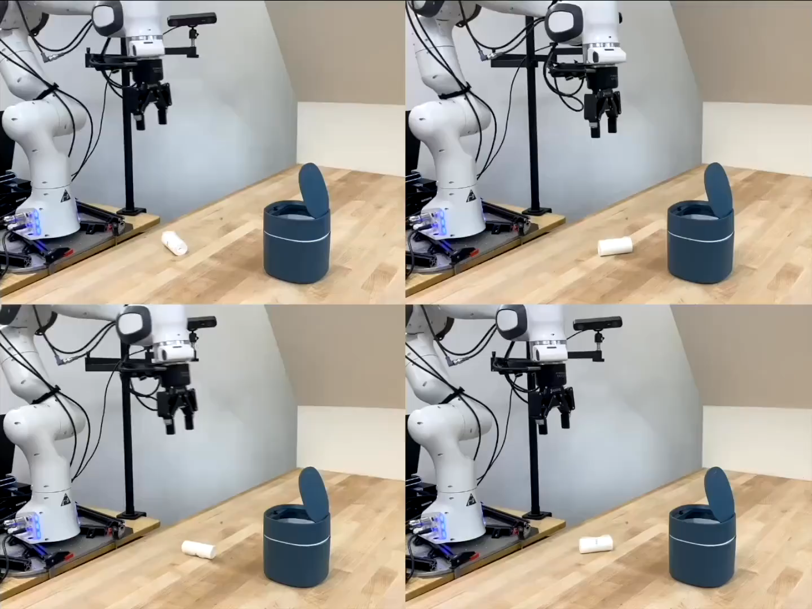
Experiments
Consistency Model
Diffusion Model

Slide 6
Thank you.

